Slide 1

Slide 1
DSC530 Term Project
Created by: David Hatchett

Slide 2


Slide 7
Background%
During the middle part of 2023, a drug shortage started for medications used to treat Attention-Deficit/Hyperactivity Disorder (ADHD). There have been many claims as to the causes, some of which were:
Lift of requirement for in-person doctor visits.
Being at home during COVID-19 drove parents to have their children diagnosed.
The ability to detect and diagnose ADHD has gotten better.
I have personally done some research previously on this subject. That research concludes that there appeared only to be a minor influx of new children Diagnosed with ADHD. The study was only conducted on datasets collected from 2016 to 2023. For this assignment, I wanted to expand the period looked at and apply new skills to the data review.
25%
Hypothesis
There was no significant change in the post-COVID-19 in the number of children diagnosed with ADHD.

Slide 3

Slide 11
The Data

Slide 4
The Data
Variables Extracted
Survey Year (SRVY_YR)
Race (HISPALLP_C)
Region (REGION)
Sex (SEX_C)
Age (AGEP_C)
Ever Told by a Doctor that you have ADHD (ADHDEV_C)
BMI (BMICAT_C)
Weight in Pounds (WEIGHTLBTC_C)
Height in Inches (HEIGHTTC_C)
Survey Weight (WTFA_C)
All the data is constructed by combining multiple years of National Health Interview Survey results. The National Center for Health Statistics conducts this survey yearly and has data from 1963. This is a distinct data set from the data the Author of Think Statas used in the book. While some of the field names and encoding can be similar, this is due to the data being produced by the same organization. For this project I create a data set combined data from 2005 to 2023 for review.
Sadly, only the children's survey contains any data on ADHD. Finding Adult data on ADHD diagnosis is rather difficult and is a gap in data for this study. For this study, I create a combined data set from 2005 to 2023 for review.
NHIS Web site

Slide 5
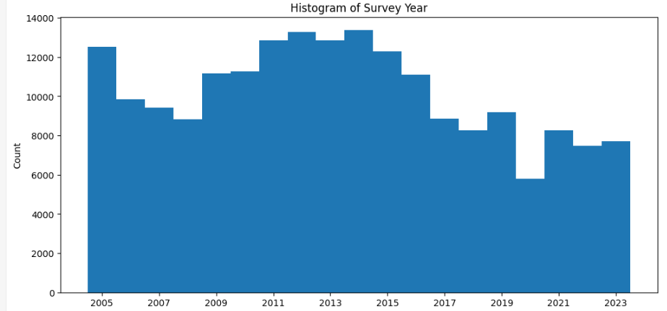
The Survey Year represents the year the survey took place. As you can see, the data ranges from 2005 to 2023. It can also be seen that different amounts of individuals were surveyed each year.
Survey Year (SRVY_YR)
Descriptive Statics
count 194302.000000
mean 2013.343949
std 5.169500
min 2005.000000
25% 2009.000000
50% 2013.000000
75% 2017.000000
max 2023.000000
Outliners and Concerns
Survey Year has no outliers, and the variance in the number of people surveyed each year can be counteracted with the WTFA_C, which is used to understand how many people the respondent represents in the total population.

Slide 6
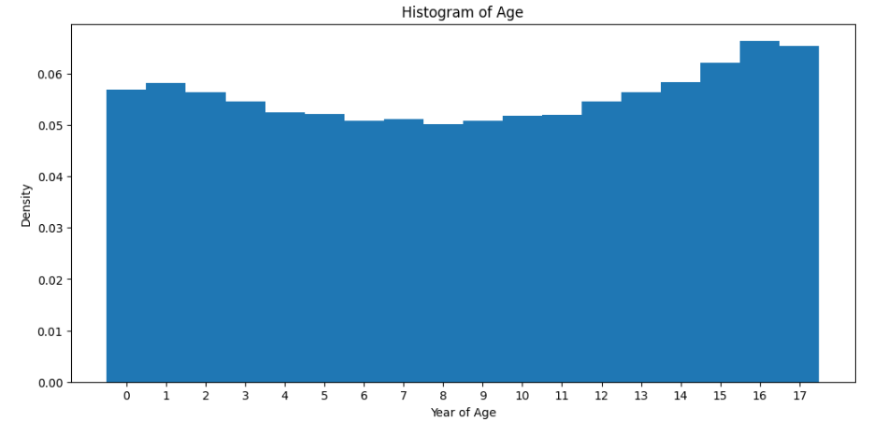
Represents the age of the respondent. As the data comes from the children's survey each year, the ages are restricted to 17 years and below.
Age (AGEP_C)
Descriptive Statics
count 194302.000000
mean 8.722031
std 5.348936
min 0.000000
25% 4.000000
50% 9.000000
75% 14.000000
max 17.000000
Outliners and Concerns
The only concern that exists with age is that it is clear that some ages are oversampled compared to others. The WTFA_C can help account for this as well.

Slide 7
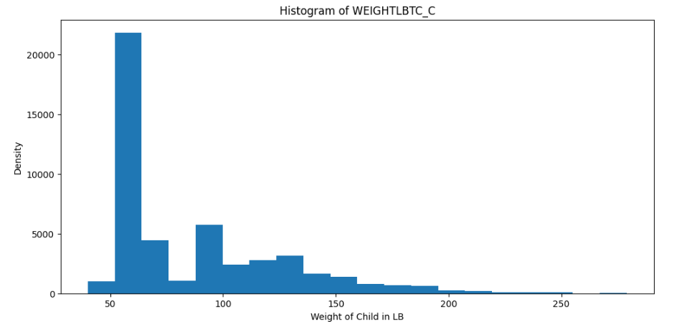
Weight in Pounds (WEIGHTLBTC_C)
Represents the age of the respondent. As the data comes from the children's survey each year, the ages are restricted to 17 years and below.
Descriptive Statics
count 48319.000000
mean 92.661003
std 38.485724
min 46.000000
25% 64.000000
50% 71.000000
75% 115.000000
max 285.000000
Outliners and Concerns
When looking at the unedited data, you will see values in the 900 + range. Those values are reserved for responses where the respondent refused or didn’t answer. They have been coded as Nan. Also, we do not have annual weight data, so we need to remove missing records when we evaluate Weight. The remaining data seems reasonable for children from 0 to 17 years of age.

Slide 8
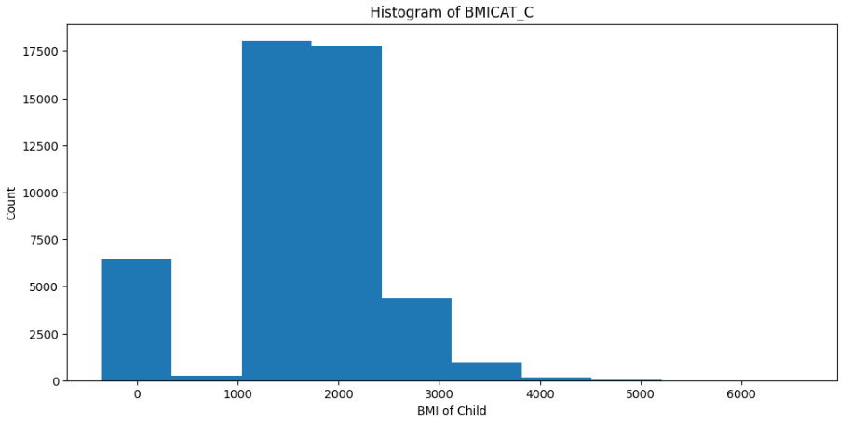
Represents the respondent's Body Mass Index (wiki). In earlier years of the survey, the BMI Value was a 4-digit number with two decimal places. IE 1949 was 19.49.
BMI (BMICAT_C)
Descriptive Statics
count 48090.000000
mean 1949.888937
std 899.113611
min 1.000000
25% 1779.000000
50% 2068.000000
75% 2414.000000
max 6945.000000
Outliners and Concerns
When you look at this histogram, you can see a significant spike at zero and spikes again at around 1000. This is due to a change in the encoding in more recent surveys. They changed the categorical data. The categorical data needs to be removed if this field is to be helpful. I failed to catch this prior to running the histogram, and it is a failure in the Data Prep Step.

Slide 9
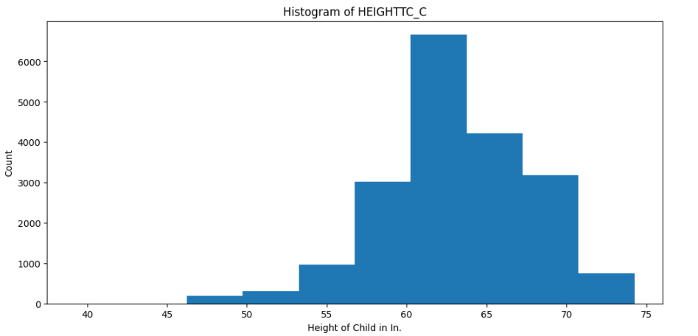
Height in Inches (HEIGHTTC_C)
Represents the Respondent's Height in Inches. There are values in the raw data in the range of 900 +. This range was reserved for unknown or refused answers. They have been coded as Nan.
Descriptive Statics
count 19311.000000
mean 64.605044
std 4.653230
min 41.000000
25% 62.000000
50% 65.000000
75% 68.000000
max 76.000000
Outliners and Concerns
While not represented here in the histogram, values were observed with values greater than 76. This is greater than 6.3 Feet tall, which is very, very rare. The volume was inconsistent with the worldwide population, so I removed them. Also, note that Height data is not available for every survey year.

Slide 10
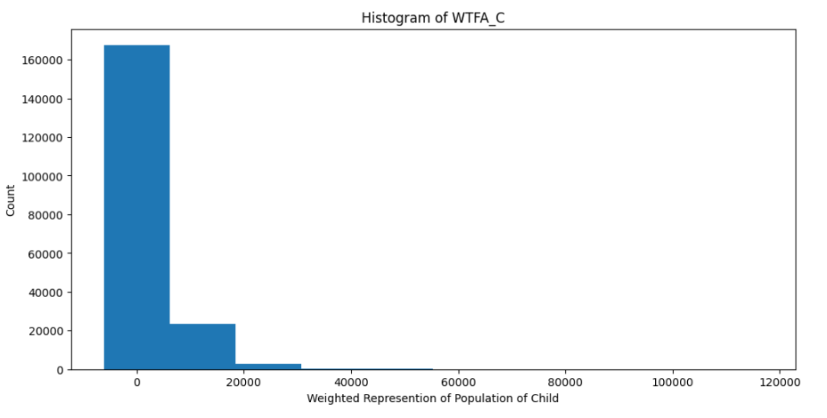
Survey Weight (WTFA_C)
This value expresses how many people each respondent represents in the US population.
Descriptive Statics
count 194302.000000
mean 7179.855383
std 5837.325984
min 63.000000
25% 3383.000000
50% 5561.000000
75% 9321.954000
max 122902.915000
Outliners and Concerns
There are no outliers here. It was just pulled to get the general idea of how many people each record represents. The piece of information I gleaned from reviewing this histogram is that there are a lot of underrepresented races and classes of people.

Slide 11
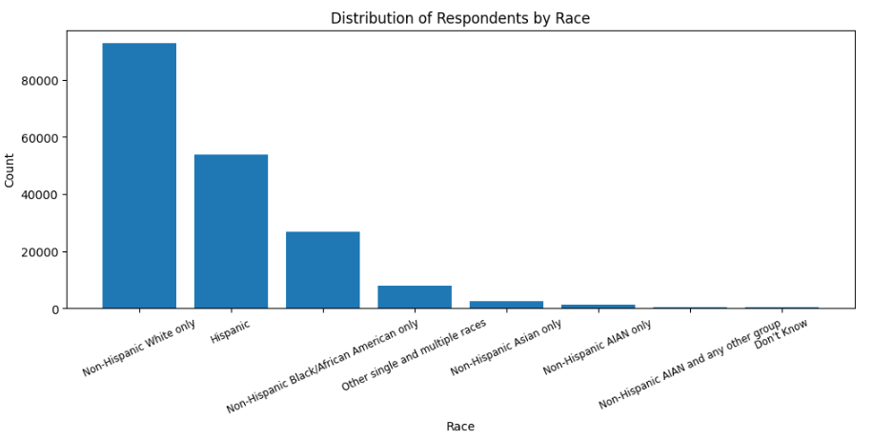
Race (HISPALLP_C)
Categorizes the Respondent by Race
Outliners and Concerns
As we can see, some races are significantly underrepresented in the population.

Slide 12
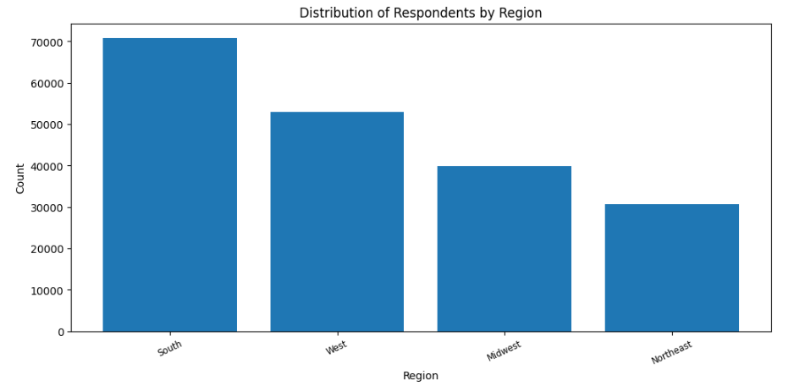
Region (REGION)
Categorize respondents by the region of the country they live in.
Outliners and Concerns
We can see that the South and West are overrepresented in the data.

Slide 13
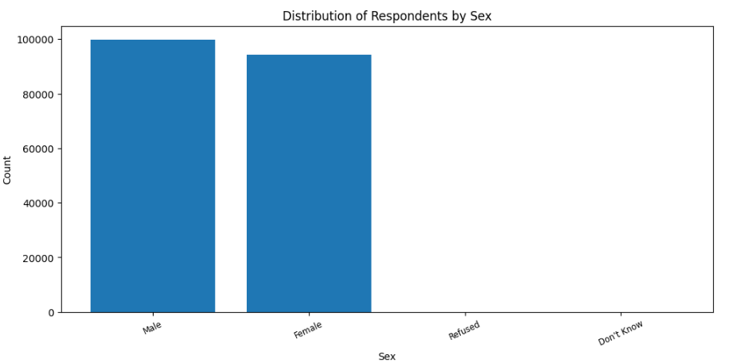
Sex (SEX_C)
Categorize respondents by their Sex.
Outliners and Concerns
Refused and Don’t Know have some values but are very low. They were also not available in the survey every year.

Slide 14
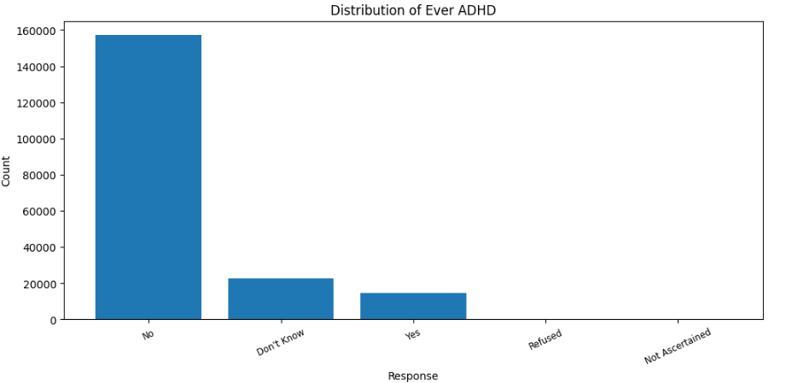
Ever Told by a Doctor that you have ADHD (ADHDEV_C)
How the respondent answered if they had ADHD or not.
Outliners and Concerns
From what I’ve seen, these numbers seem to be about right. For most, Don’t Know, Refused, and Not Ascertained will be treated as No answer.

Slide 15
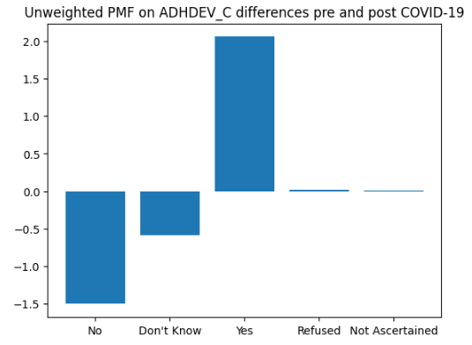
Probability Mass Function review of ADHDEV_C
I split the data into two datasets 1. Pre-COVID-19 (2005 to 2019) and 2. Post-COVID-19 (2020 to 2023). We also perform the operation for weighted and unweighted results.
Pre Covid
--------------------------------
ADHDEV_C
No 0.810951
Don't Know 0.117199
Yes 0.071407
Refused 0.000412
Not Ascertained 0.000030
Post Covid
--------------------------------
ADHDEV_C
No 0.795905
Don't Know 0.111377
Yes 0.091998
Refused 0.000616
Not Ascertained 0.000103
We can see that the probability of a Yes response is higher post-COVID-19 by about 2%. This would suggest that my Hypothesis is wrong.

Slide 16
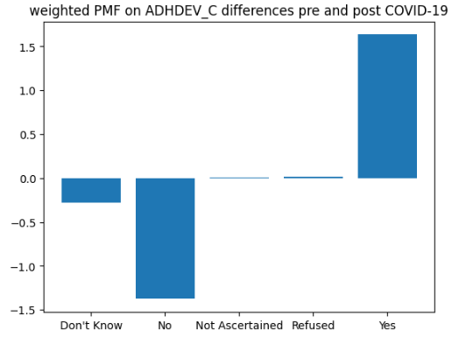
Probability Mass Function review of ADHDEV_C
I split the data into two datasets 1. Pre-COVID-19 (2005 to 2019) and 2. Post-COVID-19 (2020 to 2023). We also perform the operation for weighted and unweighted results.
Pre Covid
--------------------------------
ADHDEV_C
Don't Know 0.108053
No 0.819150
Not Ascertained 0.000038
Refused 0.000417
Yes 0.072343
Post Covid
--------------------------------
ADHDEV_C
Don't Know 0.105225
No 0.805383
Not Ascertained 0.000119
Refused 0.000595
Yes 0.088678
You can see that the weighted results are similar to the Unweighted Results.

Slide 17
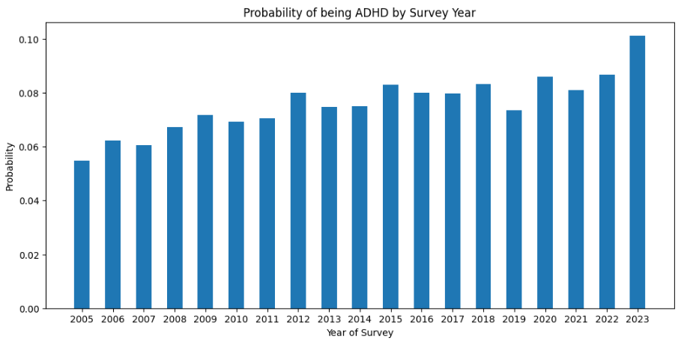
Probability Mass Function review of ADHDEV_C
I also wanted to look at the Probability of yes for each year of the survey.
From this graph, we can see that the probability of having ADHD has been rising since 2005. There is a significant spike in 2023; however, we cannot derive the cause from this graph. However, it does occur post-COVID-19 ending. Overall, this does not support my hypothesis.

Slide 18
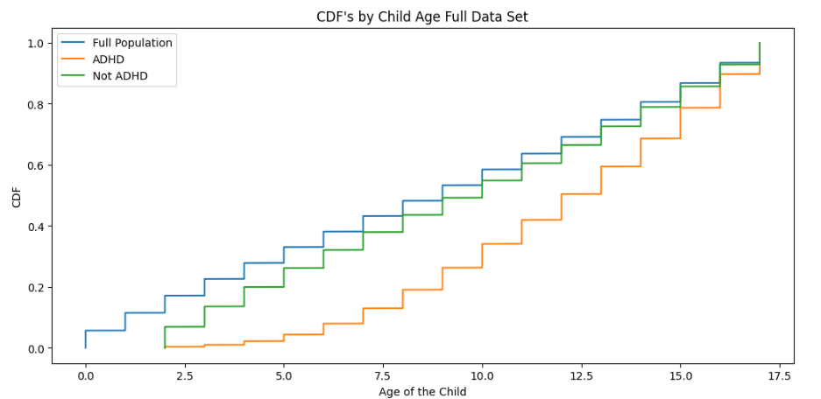
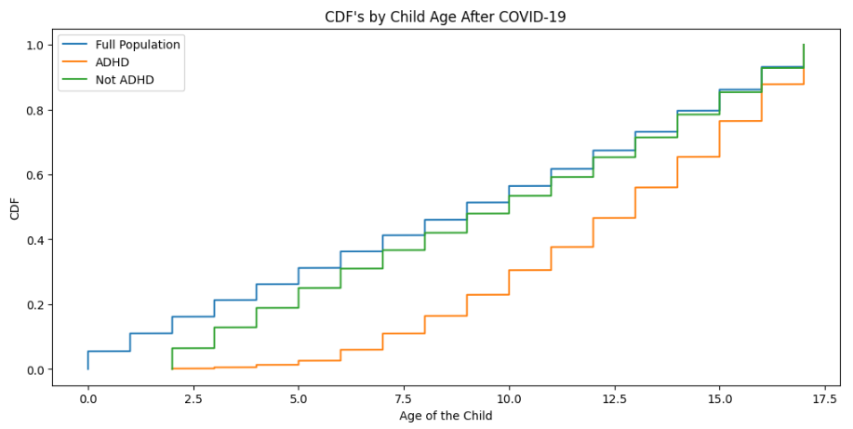
CDF of Respondent Age
I was curious as if there was a shift in the ages of children diagnosed with ADHD after COVID-19. While there are some differences, the two graphs of CDFs are similar. This would have potentially been helpful in Identifying a cause for the change in Probability.

Slide 19
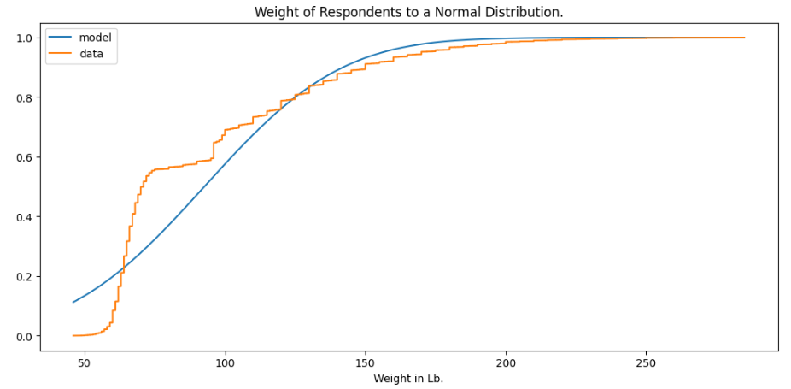
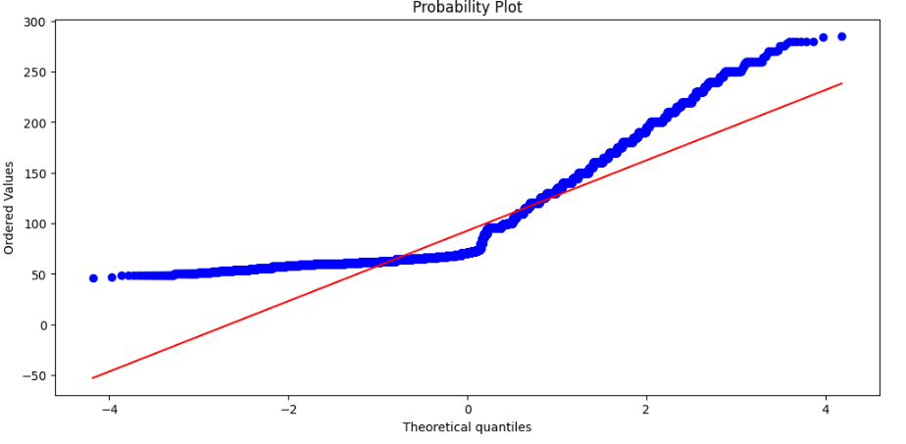
Weight of Respondents Compared to a Normal Distribution
We can see that the weights of the respondents do not fall into a Normal Distribution. I think this is occurring because of the oversampling of specific demographics that we noticed during the variable review.

Slide 20
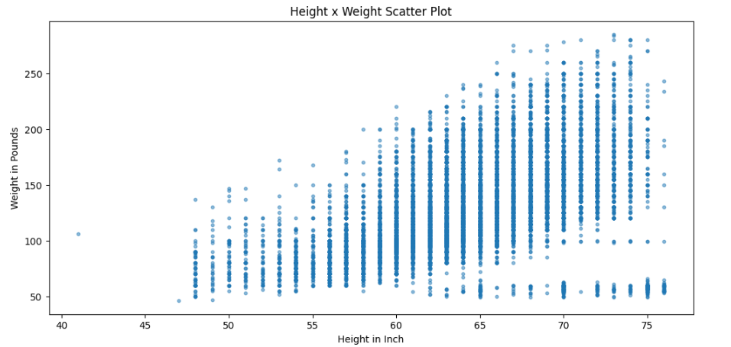
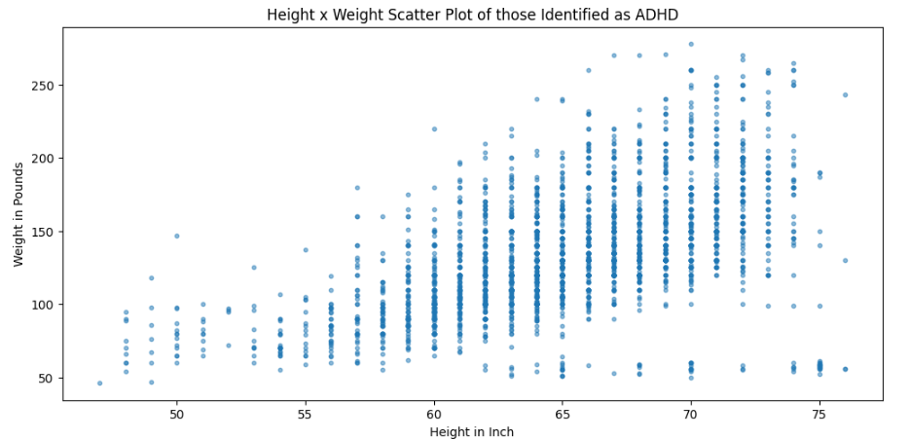
Scatter Plots of Respondent Height vs Weight
Pearson Correlation
Statistic: 0.54 Pvalue: 0.0
Spearman Correlation
Statistic: 0.59 Pvalue: 0.0
Pearson Correlation
Statistic: 0.54 Pvalue: 8.25
Spearman Correlation
Statistic: 0.58 Pvalue: 1.44
Height and Weight are somewhat correlated when we look at the entire population. However, when looking at ADHD only Respondents, the Correlation is no longer statistically relevant and may be up to chance. The ADHD may just be due to the low amount of Respondents that are ADHD.

Slide 21
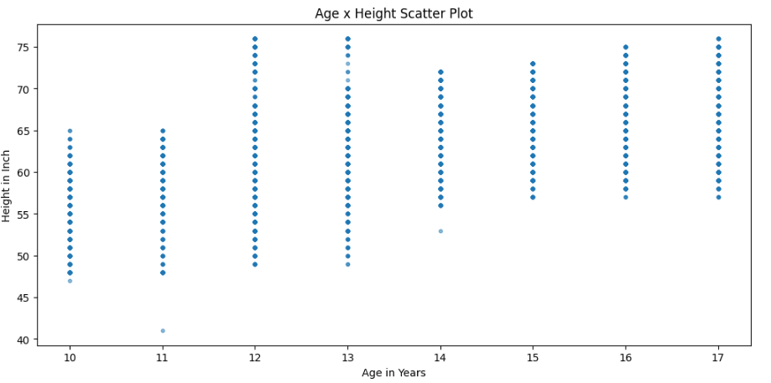
Scatter Plots of Respondent Height vs Weight
Pearson Correlation
Statistic: 1 Pvalue: 0
Spearman Correlation
Statistic: 1 Pvalue: 0
We can see that age and height are perfectly correlated, which isn’t surprising for children. It would have been far less correlated if we had run a similar chart for adults. However, I have a hunch that Respondents in the 12 to 13 Age bracket seem to be fudging their numbers. You can see that the bands shrink in size again after 14.

Slide 22
Hypothesis Testing
I chose to perform a CHI Squred Test on the Variable ADHDEV_C, reviewing if the probabilities stay the same pre and post-COVID-19.
Critical Value for 95% confidence 7.814727903251179
Test there is no difference for pre-COVID19 ADHD values compared to the full population:
Power_divergenceResult(statistic=array([24.18826901]), pvalue=array([7.32252594e-05]))
We can accept the null hypothesis here as the p-value is less than 7.81
Test there is no difference for post-COVID19 ADHD values compared to the full population:
Power_divergenceResult(statistic=array([136.7262051]), pvalue=array([1.41713201e-28]))
We can accept the null hypothesis here as the p-value is less than 7.81
Test There is no difference for post-COVID19 when Compared to pre-COVID19:
Power_divergenceResult(statistic=array([198.04384261]), pvalue=array([9.89512265e-42]))
Here, we have to reject as the p-value is greater than 7.81.
We can see from the test that there is a difference post-2020 in the probabilities in the ADHDEV_C variable. The first two tests against the ratios of the entire population pass, which is expected. This further goes to disprove my original Hypothesis of no change post-2020.

Slide 23
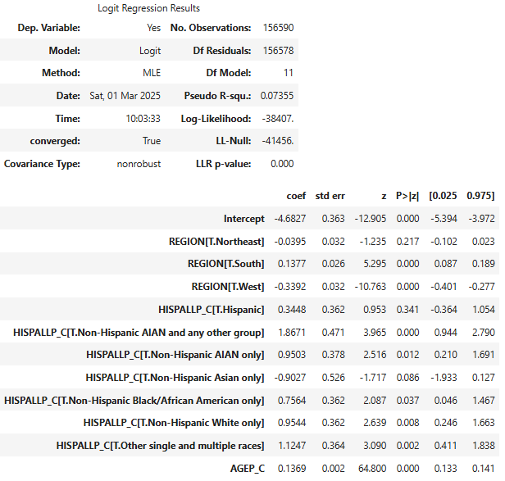
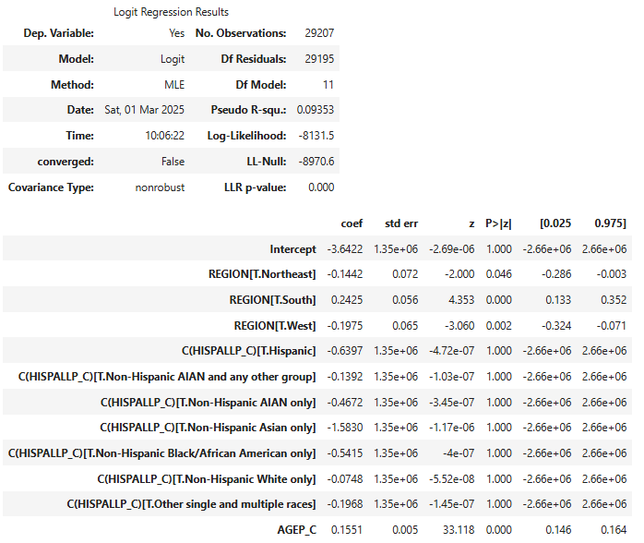
Regression Analysis
I used the Logit Regression after converting the ADHDEV_C variable into a binary field. Both models had pretty good accuracy; however, I trained on the entire dataset, so the models were tested to see if they fit on unknown data.
Pre-COVID-19
Post-COVID-19

